Slide 1
Lab 4 Data flow testing White Box testing
Maleeha Khalid Khan
Lab related to Lecture no 7 Data Flow Testing

Slide 2
Practice Related to making DFG
Draw Diagram, on notes
Than make a final diagram on Draw.io
After that make a table on MS word or excel sheet with
All define c-use
All define p-use
All du define use

Slide 3
STEPS OF DATA FLOW TESTING
Draw a data flow graph from a program.
Select one or more data flow testing criteria.
Identify paths in the data flow graph satisfying the selection criteria.
Derive path predicate expressions from the selected paths and solve those expressions to derive test input.

Slide 4
TWO FORMS OF USES OF A VARIABLE
Computation use (c-use): In c-use, a potentially new value of another variable
or of the same variable is produced.
Example: x = 2*y; /* y has been used to compute a value of x. */
Predicate use (p-use): Here the use of a variable in a predicate controlling the flow of execution.
Example: if (y > 100) { …} /* y has been used in a condition. */

Slide 5
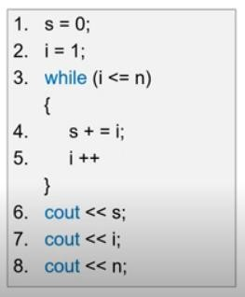
Example 1:
Variable | Defined at | Used at
s | 1 | 4,6

Slide 6
Example2:
DFT three important notations
Def (where variable is initialize)
Use (show usage)
Kill (destroyed)
6 Rules should be considered:
All definition coverage
All p-use
All c-use
All p & some c use
All c & some p-use
All uses coverage
Anomaly | Explanation
~u | Data is used without definition
~k | Data is killed before definition
dd | Define & redefine (double definition)
kk | Kill twice
ku | Kill use
d~ | Define not use

Slide 7
EXAMPLE 2 MAKE ALL POSSIBLE ANOMALIES:
Consider code:
read(x)
If(x>0)
a=x+1;
if(x<=0)
if(x<1)
x=x+1; i goto(5);
else
a=x+1;
Make all possible anomalies, c-use & p-use
(define, use, variable)
Example:
(1,(2,t),x)
(1,(2,f),x)
(1,3,x) here we have c-use
Make the rest…..

Slide 8
There is a need to draw CFG and DFG of a given code to analyze it in white box way.
public static double returnAverage(int[] value, int AS, int MIN, int MAX) {
int i = 0, ti = 0, tv = 0, sum = 0;
double av;
while (ti < AS && value[i] != -999) {
ti++; // total index … ti=ti+1
if (value[i] >= MIN && value[i] <= MAX) {
tv++; // total value
sum = sum + value[i];
}
i++;
}
if (tv > 0)
av = (double) sum / tv;
else
av = (double) -999;
return av;
}

Slide 9
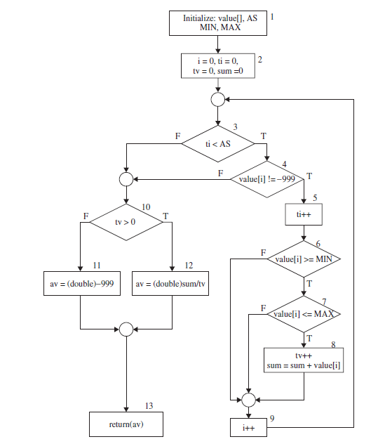
Identify Path?
How many Paths their will be ??
Path 1
Path2
?

Slide 10
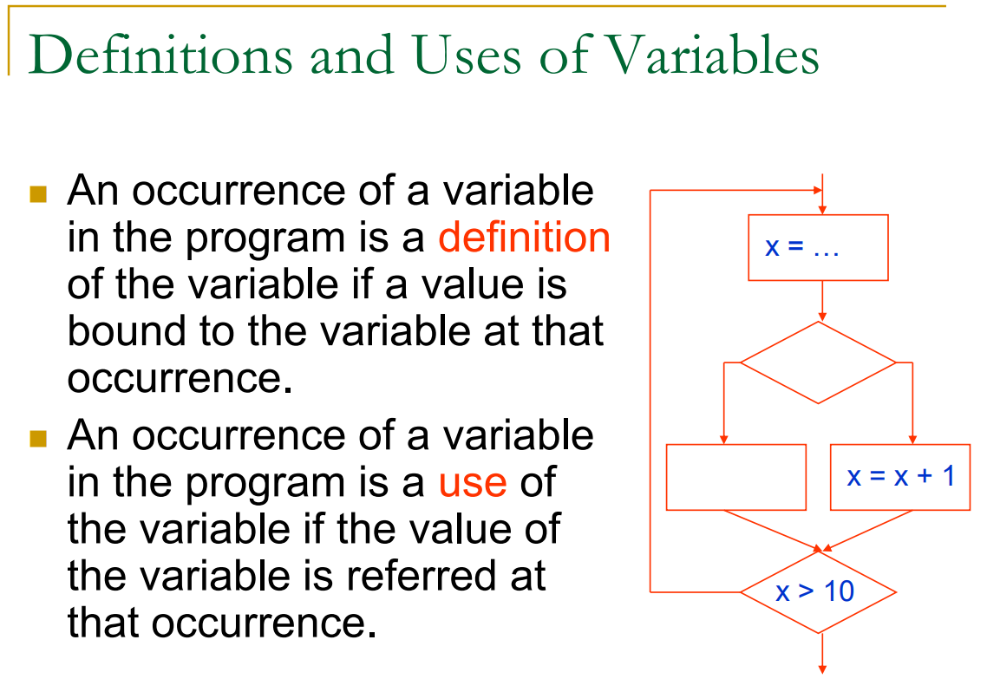

Slide 11
Node Def & C-use
Node | Def | C-use
1 | {value, AS, Min, Max}

Slide 12
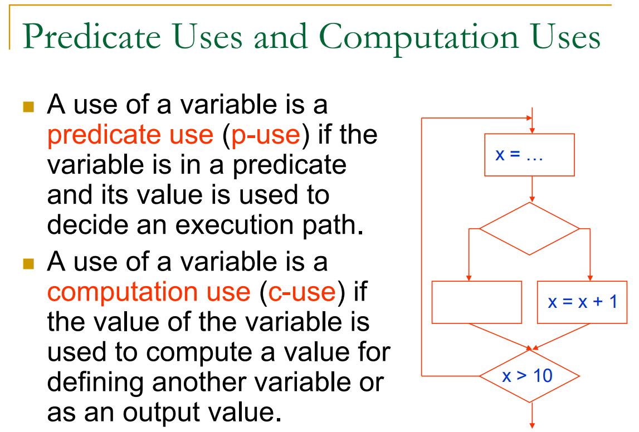

Slide 13
Edges, Predicate, P-use
Edges | Predicate | P-use
(1,2)

